Slide 1
Hollywood Most Profitable Stories
File created on: 22-06-23 12.26.36 AM

Slide 2
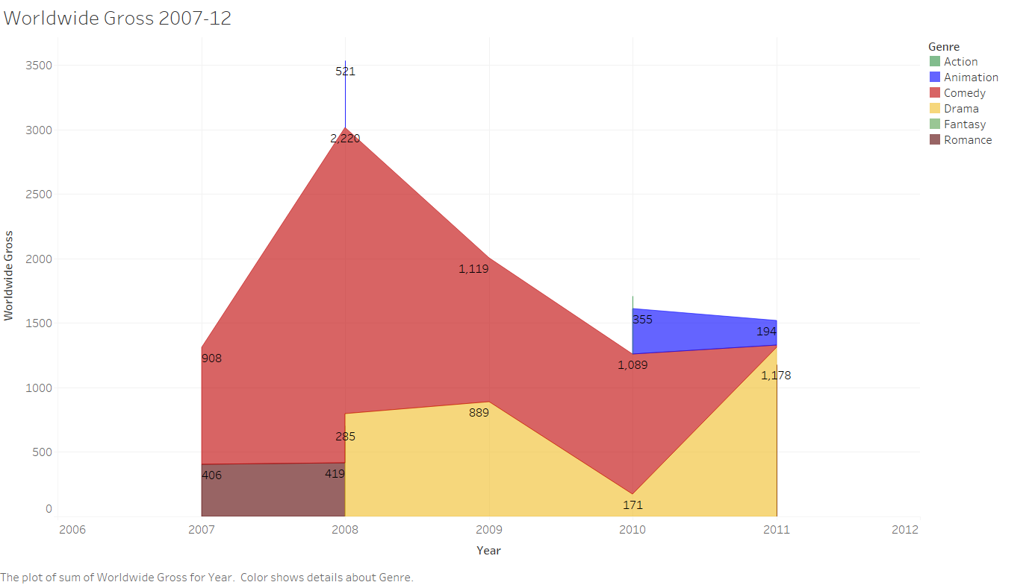

Slide 3
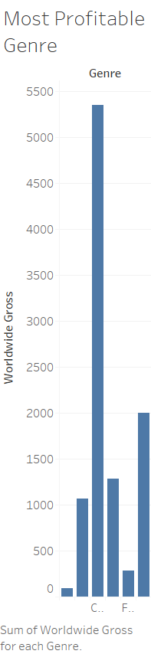

Slide 4
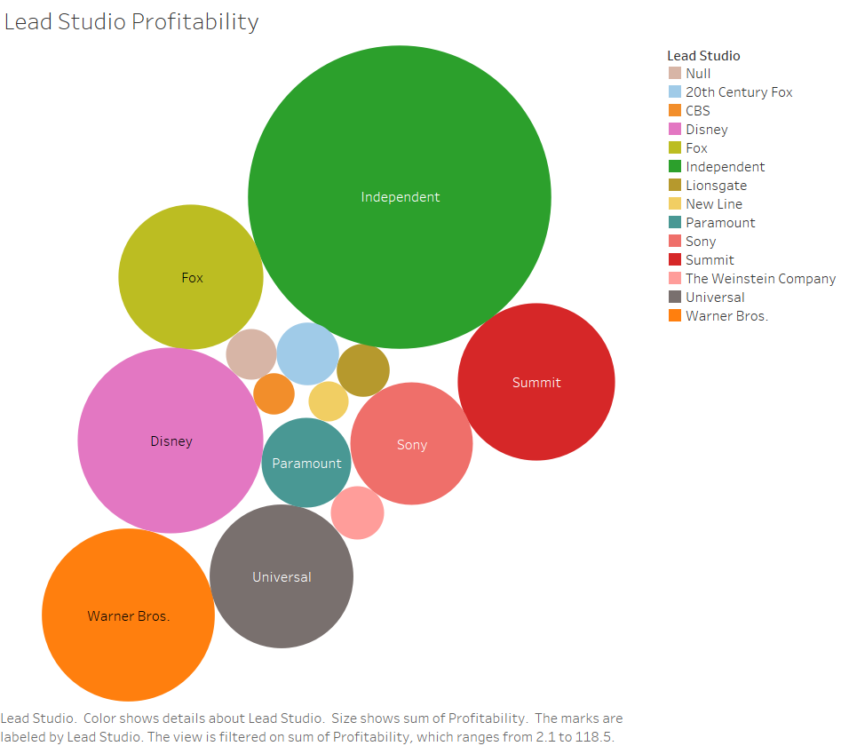

Slide 5
